Slide 1
Geodesic Saliency Using Background Priors
Yichen Wei, Fang Wen, Wangjiang Zhu, Jian Sun
Visual Computing Group
Microsoft Research Asia

Slide 2
Saliency detection is useful
Find whatever attracts visual interest
a built-in ability in human vision system
Important computer vision tasks
Image summarization, cropping…
Object (instance) matching, retrieval…
Object (class) detection, recognition…
Notes:
It’s relatively easy to find salient objects than other ones because they are …

Slide 3
What exactly is saliency?
Subjective, ambiguous and task dependent
traditionally, where a human looks
recently, where the salient object is
Categorization of methodology
top down: integrate domain knowledge
bottom up: biological observations / rules / priors

Slide 4
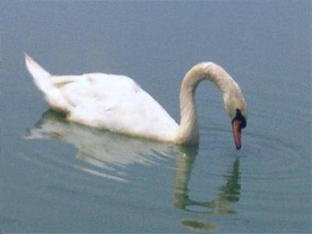
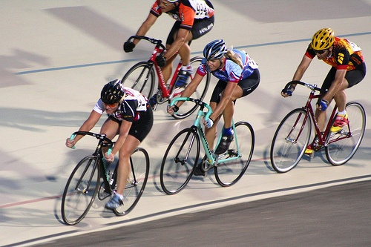
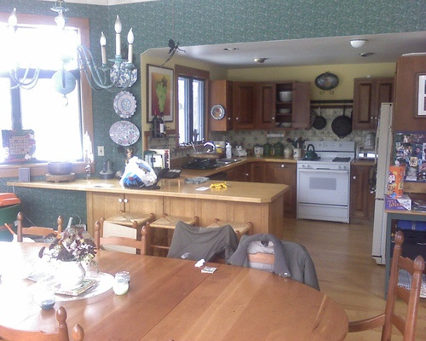
Saliency detection is challenging
Subjective and ambiguous
Hard evaluation (task-dependent)
Few theories and principles
Mostly built on image priors
$$√$$
?
$$X$$

Slide 5
Almost all work uses contrast prior
“Salient region-background contrast” is high
local, global
all those in statistics, information theory…
contrast context
contrast measure
intensity, color,
orientation, texture…
feature
primitive
pixel, patch,
window, region…
implementation
domain
spatial, frequency
pre-processing, post-processing
parameters in all above aspects …

Slide 6
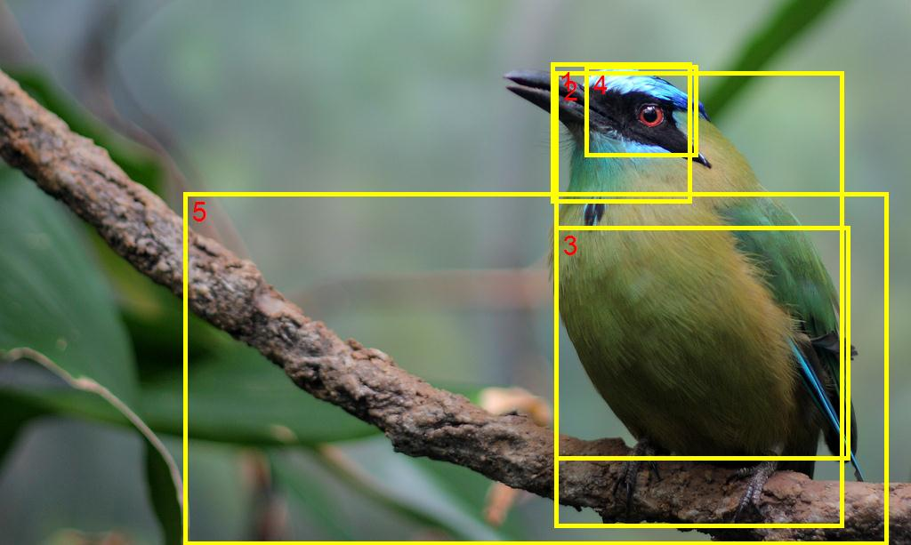
Putting our previous ‘salient window’ work in this terminology
feature: color histogram
primitive: window
contrast context: global
contrast measure: EMD
domain: spatial
pre-processing: segmentation
Salient object detection by composition, Jie Feng, Yichen Wei, Litian Tao, Chao Zhang and Jian Sun, ICCV 2011

Slide 7
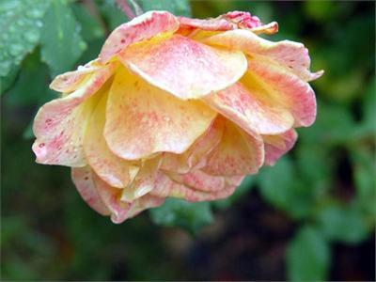
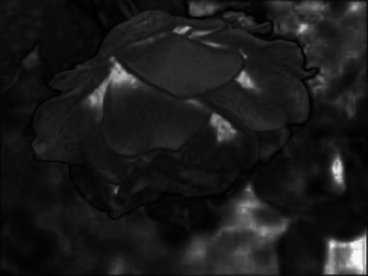
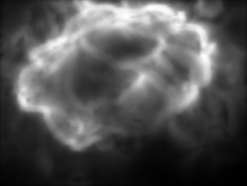
Contrast prior is insufficient
Because saliency problem is highly ill-defined
input
true mask
Itti et. al. PAMI 1998
Achanta et. al.
CVPR 2009
Goferman et. al.
CVPR 2010
Cheng et. al.
CVPR 2011

Slide 8
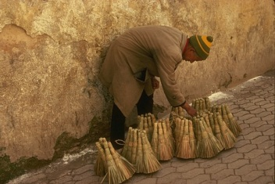
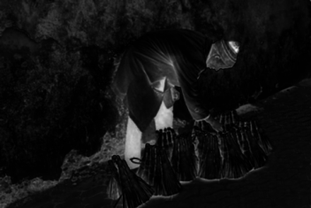
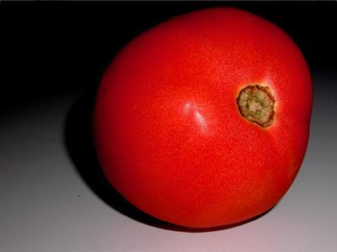
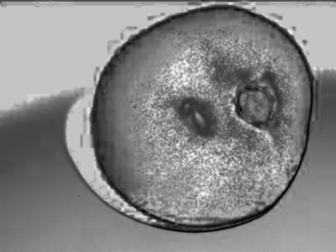
?

Slide 9
The opposite question
What is not foreground, or what is background?
Spatial information matters
arrangement, continuity…
Exploit background priors
boundary prior
connectivity prior
$$B$$
$$F$$
$$F$$
$$B$$

Slide 10
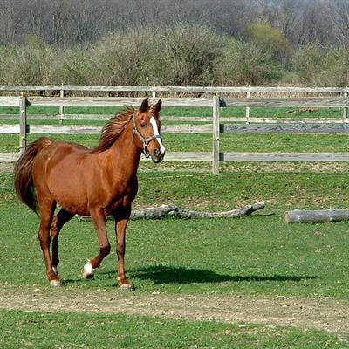
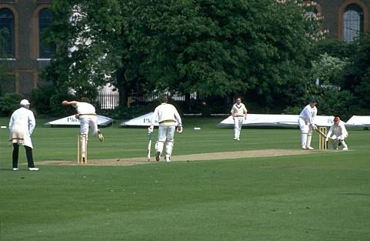
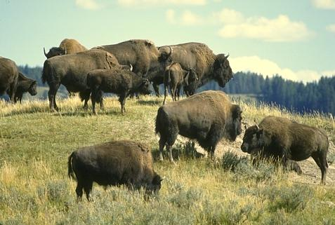
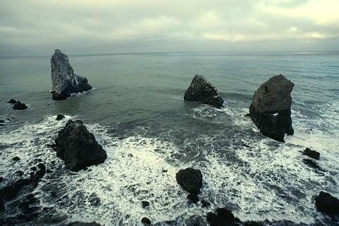
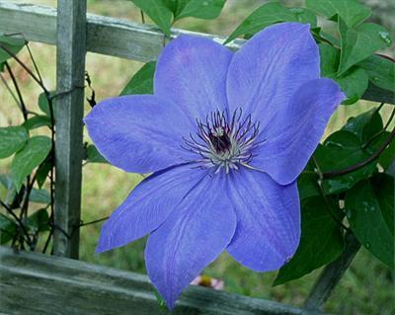
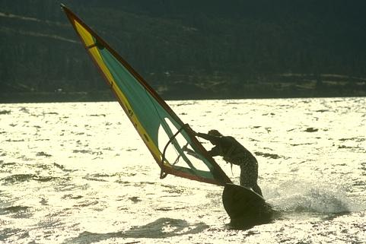
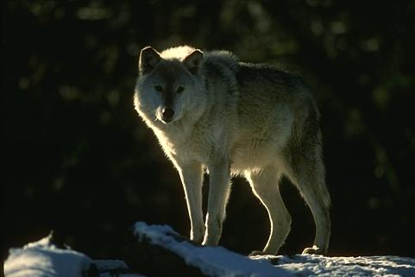
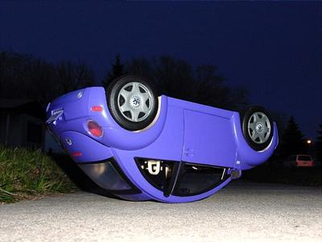
Boundary and connectivity priors
Salient objects do not touch image boundary
Backgrounds are continuous and homogeneous

Slide 11
1. Boundary prior
Salient objects do not touch image boundary
a rule in photography
more general than previous ‘image center bias’
exceptions, e.g., people cropped at image bottom

Slide 12
Evaluation of boundary prior
Distribution of background pixel percentage
only consider boundary pixels
MSRA-1000
Berkeley-300

Slide 13
2. Connectivity prior
Backgrounds are continuous and homogeneous
common characteristics of natural images
background patches are easily connected to each other
connection is piecewise (e.g., sky and grass do not connect)

Slide 14
Geodesic saliency using background priors
edge weight: appearance distance between adjacent patches
background patch
foreground patch
Geodesic saliency: length of
shortest path to image boundary
$$saliency\left(P\right)=\min_{P_{1},P_{2},…,P_{n}}\sum_{i=1}^{n−1}{distance(P_{i},P_{i+1})}$$
$$s.t. P_{1}=P, P_{n} is on image boundary, P_{i} is adjacent to P_{i+1}$$

Slide 15
Regular patches $→$ superpixels
better object boundary alignment and more accurate

Slide 16
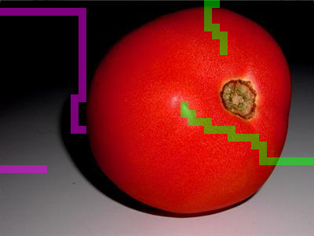
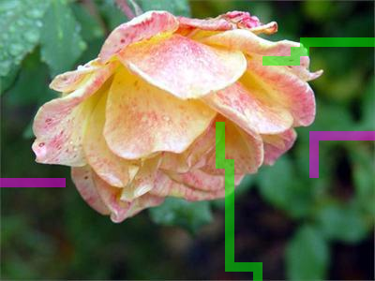
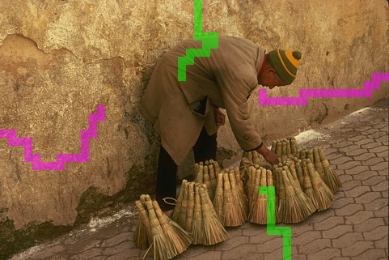
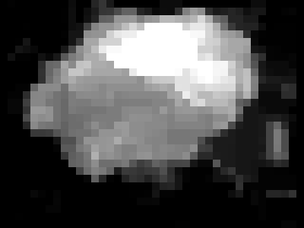
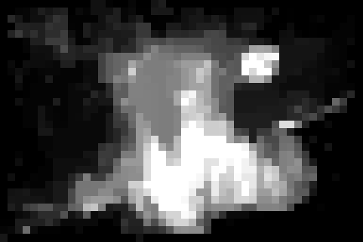
Shortest paths and results

Slide 17
Comparison with other methods
input
ours
Itti et. al.
PAMI 1998
Achanta et. al.
CVPR 2009
Goferman et. al.
CVPR 2010
Cheng et. al.
CVPR 2011

Slide 18
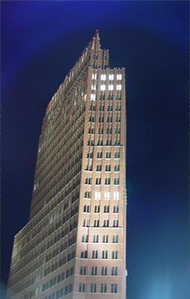
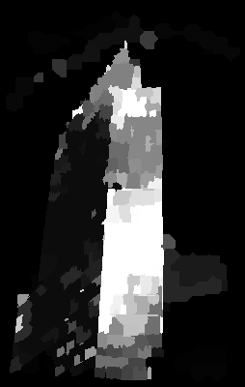
Boundary prior could be too strict
?
small cropping of object on the boundary causes large errors
Image boundary needs more robust treatment

Slide 19
Refined geodesic saliency
a virtual background node $B$
connected to boundary patches
Geodesic saliency: length of shortest path to image boundary
background node $B$
$$saliency\left(P\right)=\min_{P_{1},P_{2},…,P_{n},B}\sum_{i=1}^{n−1}{distance\left(P_{i},P_{i+1}\right)+boundary weight(P_{n},B)}$$
$$saliency\left(P\right)=\min_{P_{1},P_{2},…,P_{n}}\sum_{i=1}^{n−1}{distance(P_{i},P_{i+1})}$$
$$s.t. P_{1}=P, P_{n} is on image boundary, P_{i} is adjacent to P_{i+1}$$

Slide 20
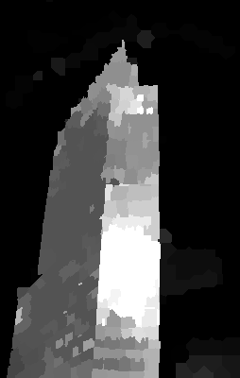
Compute boundary weight
$boundary weight\left(P,B\right)=saliency of P on the boundary$
?
boundary weight as a 1D saliency problem
Goferman et. al. CVPR 2010
result with boundary weight
result w/o boundary weight

Slide 21
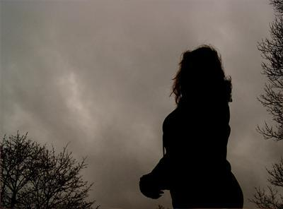
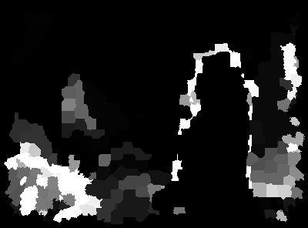
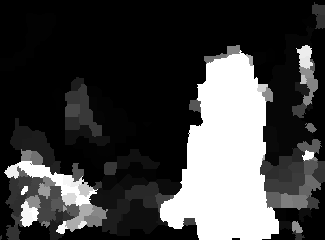
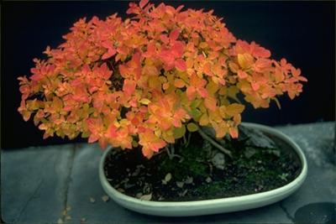
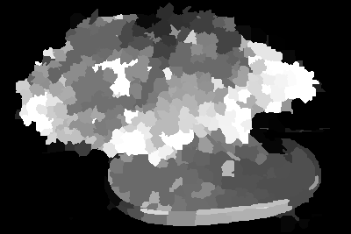
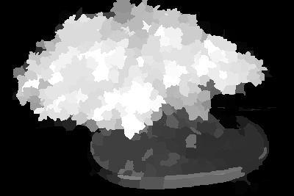
Boundary weight improves results
input
result w/o boundary weight
boundary weight
result with boundary weight

Slide 22
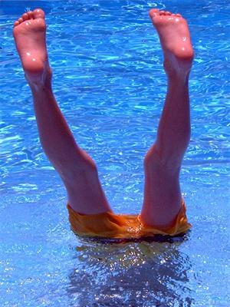
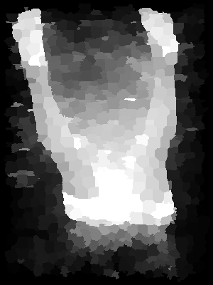
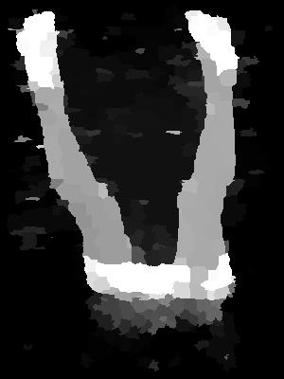
“Small-weight-accumulation” problem
$if distance\left(P_{i},P_{i+1}\right)<t, it is clipped to 0$
$t$: a small value indicating an insignificant distance
with weight clipping

Slide 23
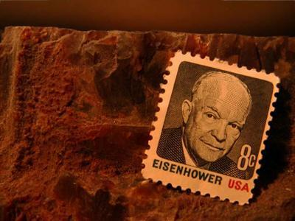
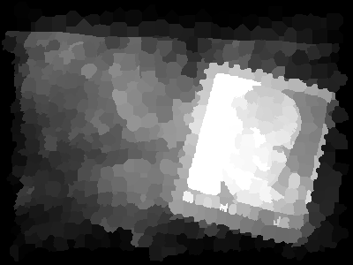
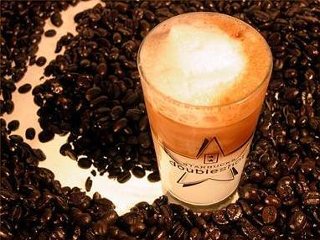
Weight clipping improves results
w/o weight clipping
with weight clipping

Slide 24
Advantages of geodesic saliency
Effective combination of three priors
moderate usage of contrast prior
complementary to other algorithms
Easy interpretation
just one parameter: patch size (fixed as 1/40 image size)
Super fast (2 ms, 400x400 image, regular patches)

Slide 25
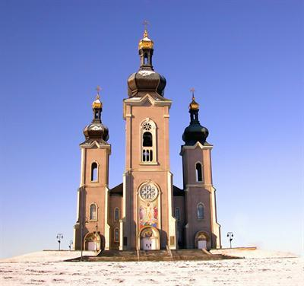
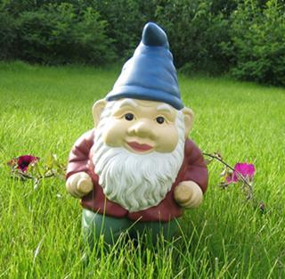
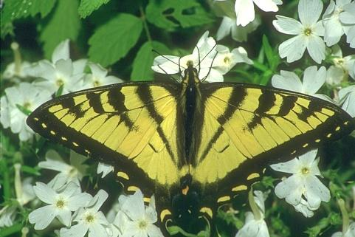
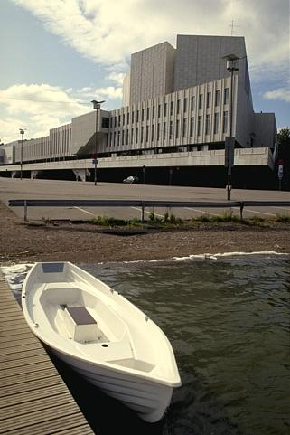
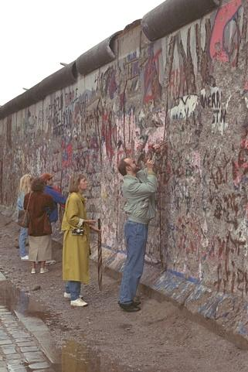
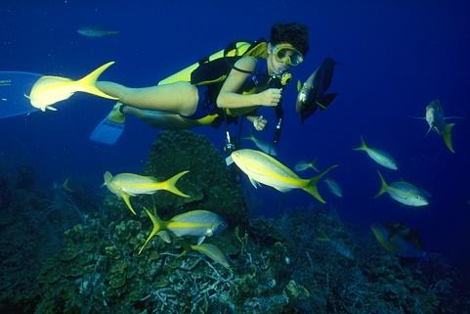
Two salient object databases
MSRA-1000, simple
Berkeley-300, difficult
one object
large
near center
clean background
one or multiple object
different sizes
different positions
cluttered background

Slide 26
Running performance comparison
methods | time (ms)
Our approach | 2.0
FT (Achanta et. al. CVPR 2009) | 8.5
LC (Zhai et. al. MM 2006) | 9.6
HC (Cheng et. al. CVPR 2011) | 10.1
SR (Hou et. al. CVPR 2007) | 34
RC (Cheng et. al. CVPR 2011) | 134.5
IT (Itti et. al. PAMI 1998) | 483
GB (Harel et. al. NIPS 2006) | 1557
CA (Goferman et. al. CVPR 2010) | 59327

Slide 27
Performance evaluation on MSRA-1000
GS_GD: geodesic saliency using rectangular patches
GS_SP: geodesic saliency using superpixels

Slide 28
Geodesic saliency is complementary to other algorithms
Geodesic saliency relies on background priors
previous methods mainly rely on contrast prior
Combination improves both

Slide 29
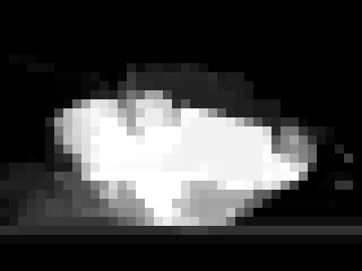
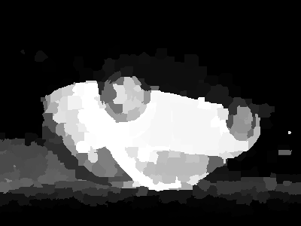
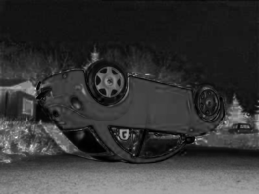
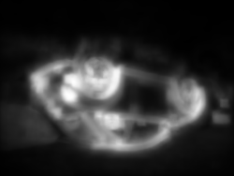
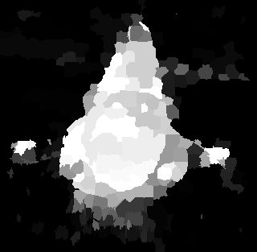
Results on MSRA-1000
Image
True Mask
GS_GD
GS_SP
FT [9]
CA [11]
GB [22]
RC [12]

Slide 30
Performance evaluation on Berkeley-300
GS_GD: geodesic saliency using rectangular patches
GS_SP: geodesic saliency using superpixels

Slide 31
Results on Berkeley-300
Image
True Mask
GS_GD
GS_SP
FT [9]
CA [11]
GB [22]
RC [12]

Slide 32
Failure examples

Slide 33
Summary of geodesic saliency
Better usage of background priors
State-of-the-art in both accuracy and efficiency
Complementary to other methods

